Slide 1
Social media posts on the exchange periods of Vamia’s students
Tips for the text, pictures, and videos of the posts

Slide 2
Who are you, what do you study, and what’s the location of your exchange period? (country, city, and your school or working place)
Questions that your post can answer
Have you enjoyed your exchange period so far?
Tell us about the location and what you’ve learned there.
Have you encountered something surprising, something unexpected?
If you’d have to name one favourite thing about your exchange period, what would that be?

Slide 3
Have you experienced any mishaps, homesickness, or culture clash?
Why did you want to go on an exchange period?
Is it worth going on an exchange period, and why would you say so?

Slide 4
What kind of pictures to choose?
Also nice are snapshots of the place you work at, or something related to the tasks you’ve performed there.
Best choices are the pictures with people in them, such as a picture of you at the exchange school or workplace, or maybe a local tourist attraction.
Pictures taken with your phone work very well!

Slide 5
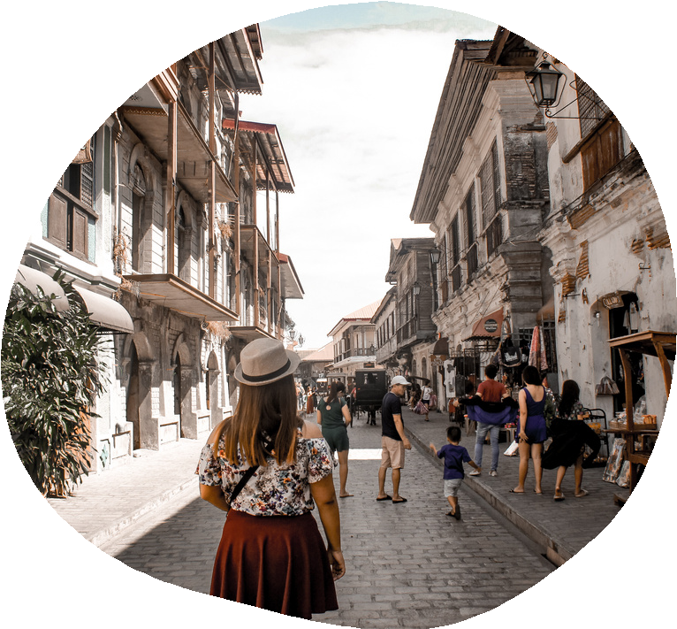
Ideally not only landscape shots, even though some of them can definitely be mixed in!
If you’d prefer not to show your face, you can also be in the frame with your back to the camera.
Pictures showcasing the local culture through events, food, or other cultural elements mentioned in the post.

Slide 6
Video material of your exchange period
We’d love to see video clips or short video compilations of your exchange period!
Send us a video of your daily routines, for example, a “My Day As an Exchange Student” style video, or share some clips of your most awesome experiences!
If you want to, you can speak in the video, and if you don’t, you can also add some text to explain the contents.
To keep the quality of the video good, you can send the file by email or download it on Onedrive or Google Drive and share the link.
Due to copyright issues, it’s better to add background music (if you want that) only when the video is about to be published.

Slide 7
Here we’ve listed only a few tips, but the post about your exchange period can look very different, too!
You can send the text and the photos of your post to your own exchange coordinator.
Check out Vamia’s Facebook for the existing posts on our students’ exchange periods for reference!
Questions or ideas? Contact us! eveliina.koskela@vamia.fi

